Slide 1
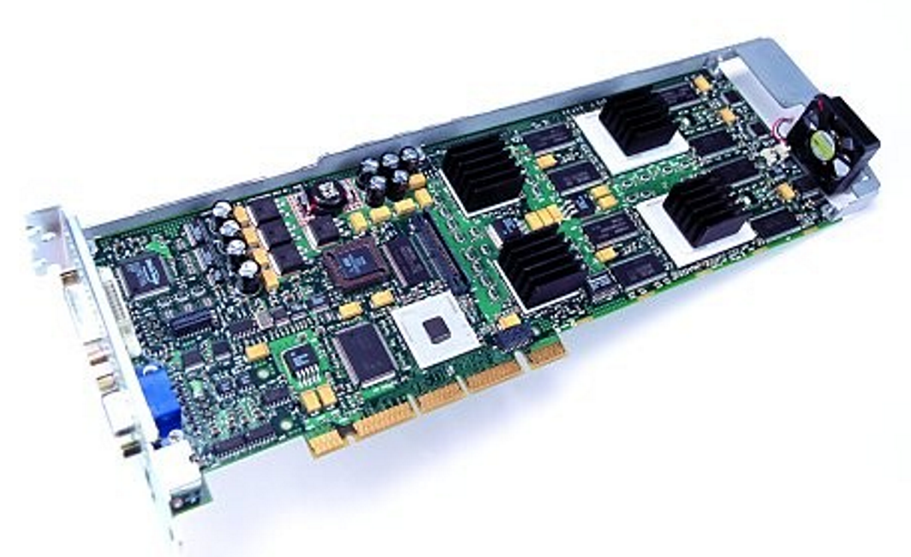
Computing Architectures for Virtual Reality

Slide 2
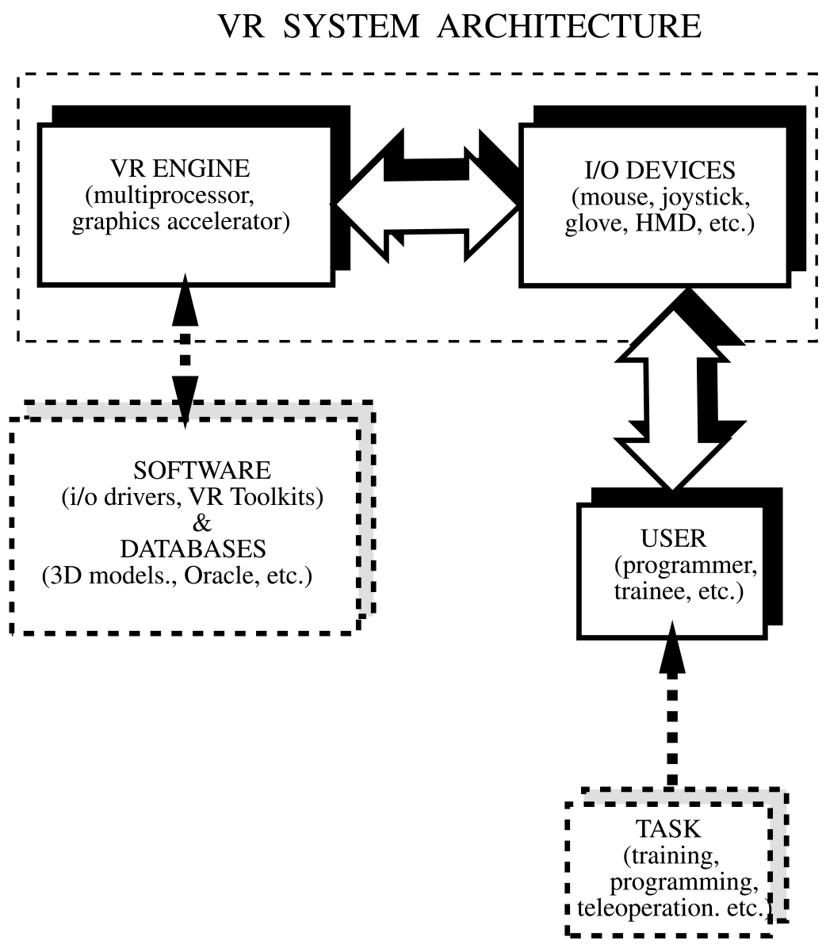

Computer
(rendering
pipeline)
System architecture

Slide 3
Computing Architectures
The VR Engine
Definition:
A key component of the VR system which reads its input devices,
accesses task-dependent databases, updates the state of the
virtual world and feeds the results to the output displays.
It is an abstraction – it can mean one computer, several
co-located cores in one computer, several co-located computers,
or many remote computers collaborating in a distribute simulation

Slide 4
Computing Architectures
The real-time characteristic of VR requires a VR engine
which is powerful in order to assure:
fast graphics and haptics refresh rates (30 fps for graphics and
hundreds of Hz for haptics);
low latencies (<100 ms to avoid simulation sickness);
at the core of such architecture is the rendering pipeline.
within the scope of this course rendering is extended to include
haptics

Slide 5
Computing Architectures
The Graphics Rendering Pipeline
The process of creating a 2-D scene from a 3-D model is
called “rendering.” The rendering pipeline has three
functional stages. The speed of the pipeline is that of its
slowest stage.
Application
Geometry
Rasterizer

Slide 6
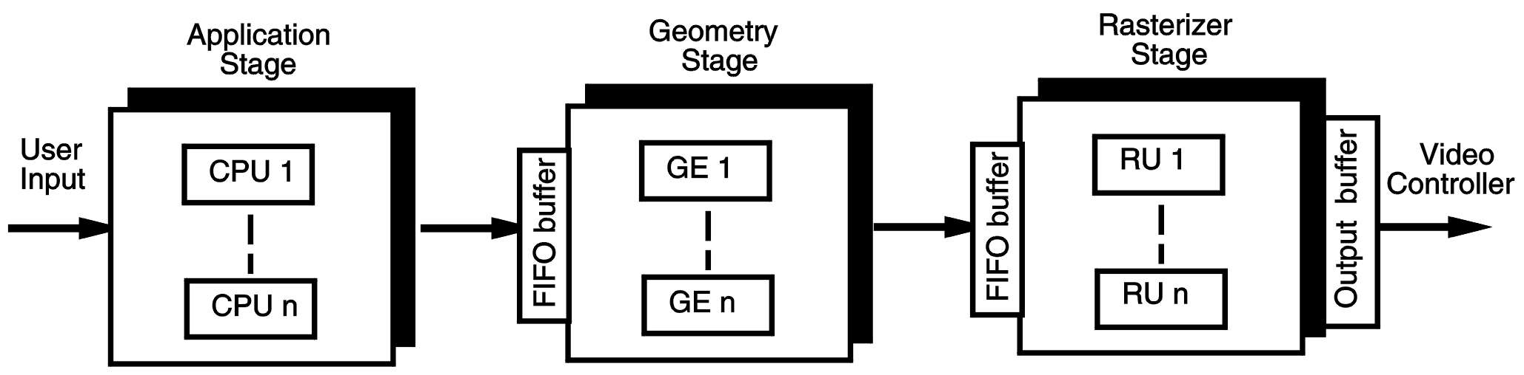
The Graphics Rendering Pipeline
Old rendering pipelines were done in software (slow)
Modern pipeline architecture uses parallelism
and buffers. The application stage is implemented in software,
while the other stages are hardware-accelerated.

Slide 7
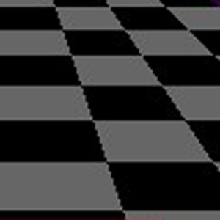

Modern pipelines also do anti-aliasing for points, lines or the whole scene;
Aliased polygons
(jagged edges)
Anti-aliased polygons

Slide 8
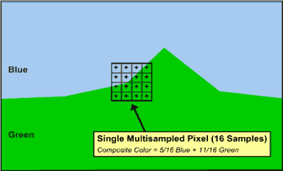
How is anti-aliasing done? Each pixel is subdivided
(sub-sampled) in n regions, and each sub-pixel has a color;
The anti-aliased pixel is given a shade of green-blue
(5/16 blue + 11/16 green). Without sub-sampling the
pixel would have been entirely green – the color of
the center of the pixel (from Wildcat manual)

Slide 9
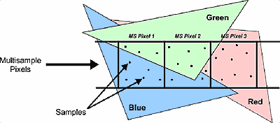
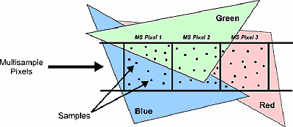
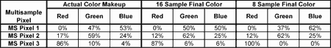
More samples produce better anti-aliasing;
8 sub-samples/pixel
16 sub-samples/pixel
From Wildcat “SuperScene” manual
http://62.189.42.82/product/technology/superscene_antialiasing.htm

Slide 10
Computing Architectures
The Rendering Pipeline
Application
Geometry
Rasterizer

Slide 11
The application stage
Is done entirely in software by the CPU;
It reads Input devices (such as gloves, mouse);
It changes the coordinates of the virtual camera;
It performs collision detection and collision
response (based on object properties) for haptics;
One form of collision response if force feedback.

Slide 12
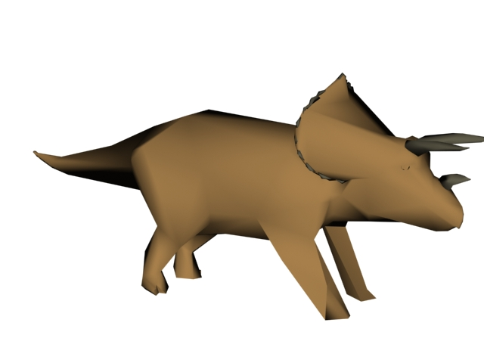
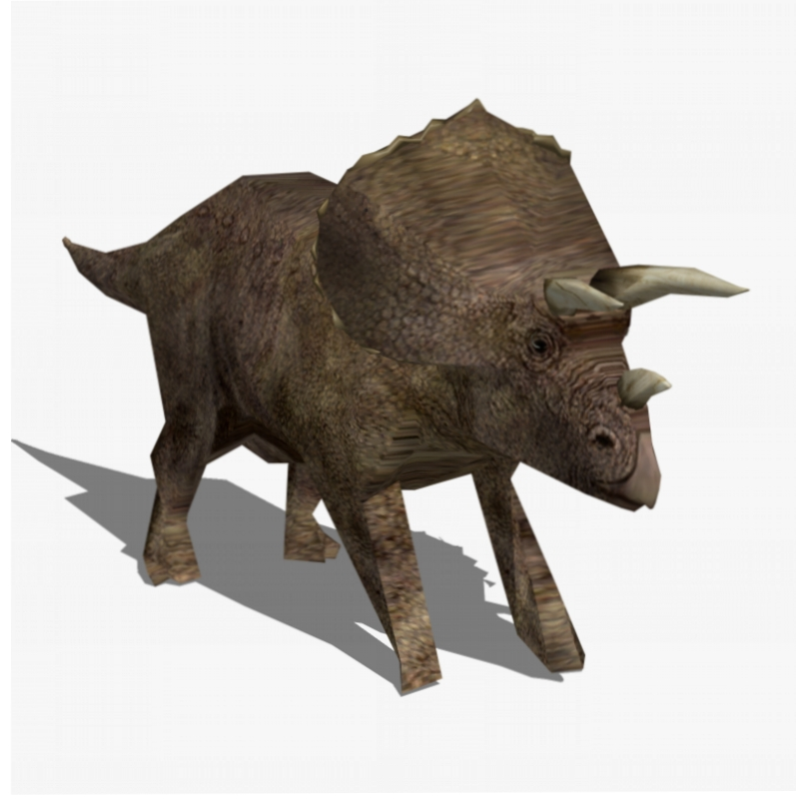
Application stage optimization…
Reduce model complexity (models with less polygons – less to feed down the pipe);
Low res. Model
~ 600 polygons
Higher resolution model
134,754 polygons.

Slide 13
Application stage optimization…
Reduce floating point precision (single precision
instead of double precision)
minimize number of divisions
Since all is done by the CPU, to increase
speed a dual-processor (super-scalar) architecture
is recommended.

Slide 14
Computing Architectures
The Rendering Pipeline
Application
Geometry
Rasterizer
Rendering pipeline

Slide 15
The geometry stage
Is done in hardware;
Consists first of model and view transforms
Next the scene is shaded based on light models;
Finally the scene is projected, clipped, and
mapped to the screen coordinates.

Slide 16
The lighting sub-stage
It calculates the surface color based on:
type and number of simulated light sources;
the lighting model;
the reflective surface properties;
atmospheric effects such as fog or smoke.
Lighting results in object shading which makes
the scene more realistic.

Slide 17
The lighting sub-stage optimization…
It takes less computation for fewer lights
in the scene;
The simpler the shading model, the less
computations (and less realism):
Wire-frame models;
Flat shaded models;
Gouraud shaded;
Phong shaded.

Slide 18
The lighting models
Wire-frame is simplest – only shows polygon
visible edges;
The flat shaded model assigns same color to all
pixels on a polygon (or side) of the object;
Gouraud or smooth shading interpolates colors
Inside the polygons based on the color of the edges;
Phong shading interpolates the vertex normals
before calculating the light intensity based on the
model described – most realistic shading model.

Slide 19
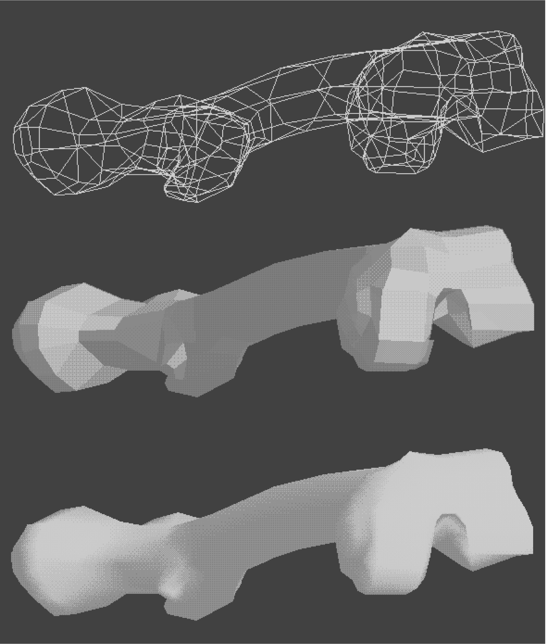
Computing architectures
Wire-frame model
Flat shading model
Gouraud shading model

Slide 20
The rendering speed vs. surface polygon type
The way surfaces are described influences rendering speed.
If surfaces are described by triangle meshes, the rendering will
be faster than for the same object described by independent
quadrangles or higher-order polygons. This is due to the
graphics board architecture which may be optimized to render
triangles.
Example the rendering speed of SGI Reality Engine.

Slide 21
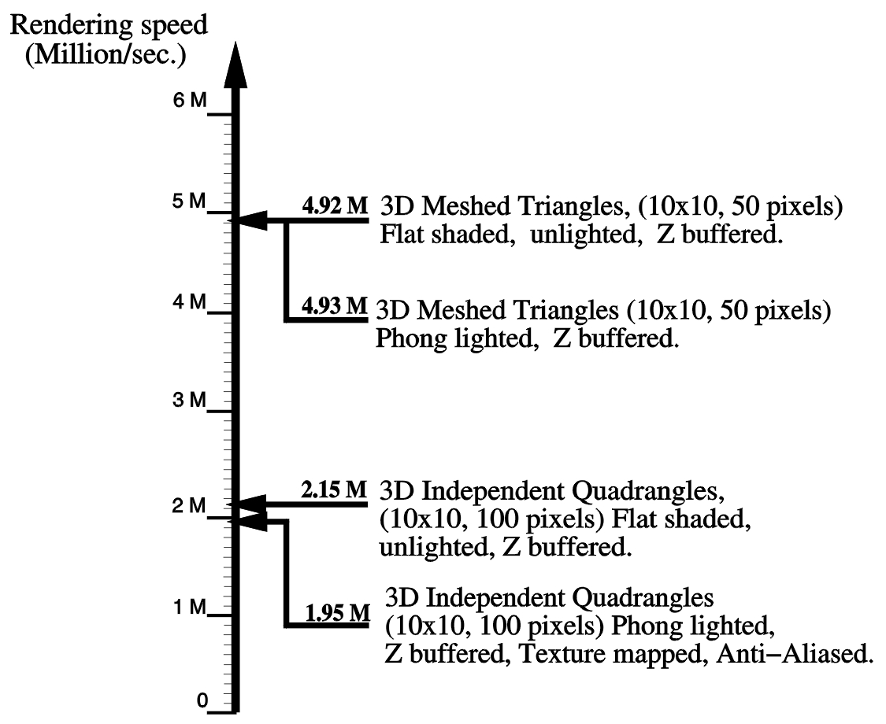
SGI Onyx 2 with Infinite Reality

Slide 22
Computing Architectures
The Rendering Pipeline
Application
Geometry
Rasterizer

Slide 23
The Rasterizer Stage
Performs operations in hardware for speed;
Converts 2-D vertices information from the
geometry stage (x,y,z, color, texture) into pixel
information on the screen;
The pixel color information is in color buffer;
The pixel z-value is stored in the Z-buffer (has
same size as color buffer);
Assures that the primitives that are visible from
the point of view of the camera are displayed.

Slide 24
The Rasterizer Stage - continued
The scene is rendered in the back buffer;
It is then swapped with the front buffer which
stores the current image being displayed;
This process eliminates flicker and is called
“double buffering”;
All the buffers on the system are grouped into the
frame buffer.

Slide 25
Testing for pipeline bottlenecks
If CPU operates at 100% – then the pipeline is
“CPU-limited” (bottleneck in application stage);
If the performance increases when all light
sources are removed, then the pipeline is
“transform-limited” (bottleneck in geometry stage);
If the performance increases when the resolution
of the display window, or its size are reduced
then the pipeline is “fill-limited” (bottleneck in
rasterizer stage).

Slide 26
Transform-limited
(reduce level of detail)
Fill-limited
(increase realism)

Slide 27
The Pipeline Balancing
Single buffering
Application
(75%)
Geometry
(75%)
Rasterizer
(100%)
Double buffering, balanced pipeline
Application
(90%)
Geometry
(95%)
Rasterizer
(100%)

Slide 28
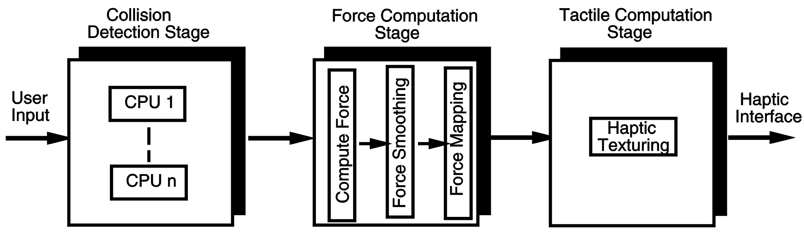
Computing Architectures
The Haptics Rendering Pipeline
The process of computing the forces and mechanical textures
Associated with haptic feedback. Is done is software and in
hardware. Has three stages too.

Slide 29
PC graphics architecture – PC is King!
Went from 66 MHz Intel 486 in 1994 to 3.6 GHz Pentium IV today;
Newer PC CPUs are dual (or quad) core – improves performance by 50%
Went from 7,000 G-shaded poly./sec (Spea Fire board) in 1994 to 27 Mil G-shaded poly/sec.
Today PCs are used for single or multiple users, single
or tiled displays;
Intensely competitive industry.

Slide 30
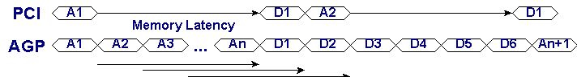
PC bus architecture – just as important
Went from 33 MHz “Peripheral Component Interface”
(PCI) bus to 264 MHz “Accelerated Graphics Port”
(AGP4x) bus, and doubled again in the AGP8x;
Larger throughput and lower latency since address bus
lines decoupled from data lines. AGP uses “sideband” lines

Slide 31
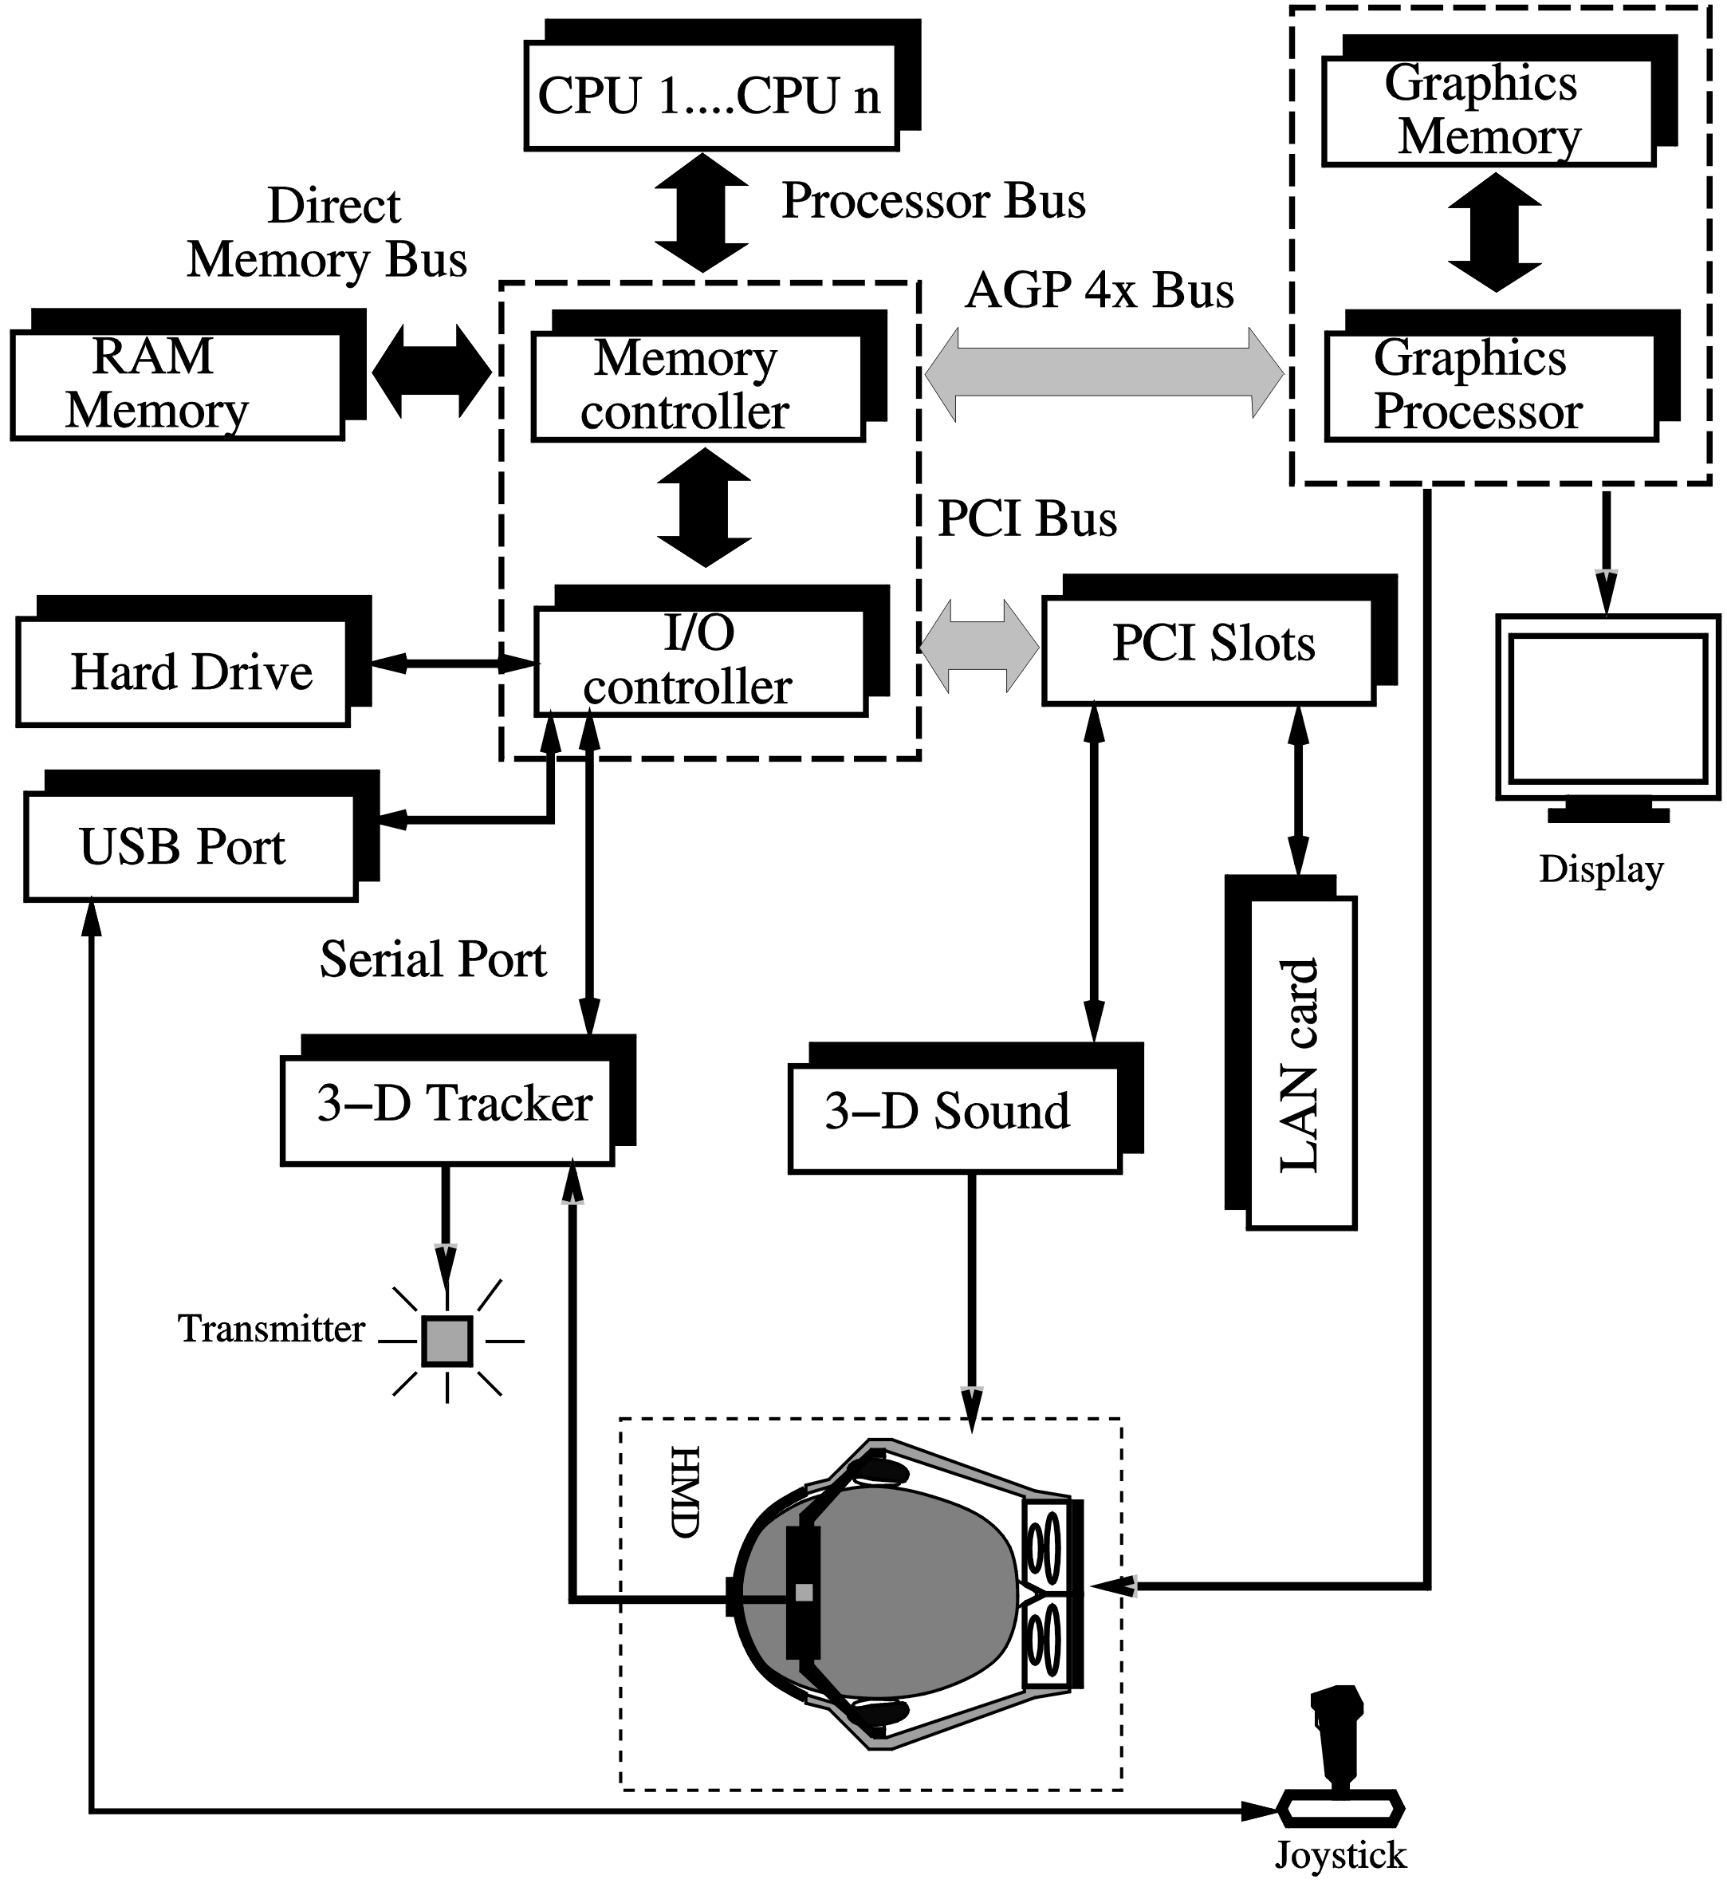
Intel 820/850
chipset
Graphics
Accelerator
(memory +
processors
AGP 8x rate ~ 2 GBps
unidirectional
533 MHz x 32 bit/sec
PCI transfer rate ~ 133 MBps
33 MHz x 32 bit/sec
PCI Express rate ~ 4 GBps
bidirectional
Today’s PC system architecture

Slide 32
The SGI InfiniteReality computer:
A massively parallel architecture based on proprietary
ASIC technology; Was considered for a long time the “crème-de-la-crème” in VR computers.
Can have up to 10,000 CPUs in the application stage,
The geometry board consists of a “host interface processor” (HIP), a “geometry distributor” and geometry engines (with a FIFO queue);
The HIP task is to pull data from main memory (using DMA); it also has its own 16 MB cache, such that the need to pull data is reduced.

Slide 33
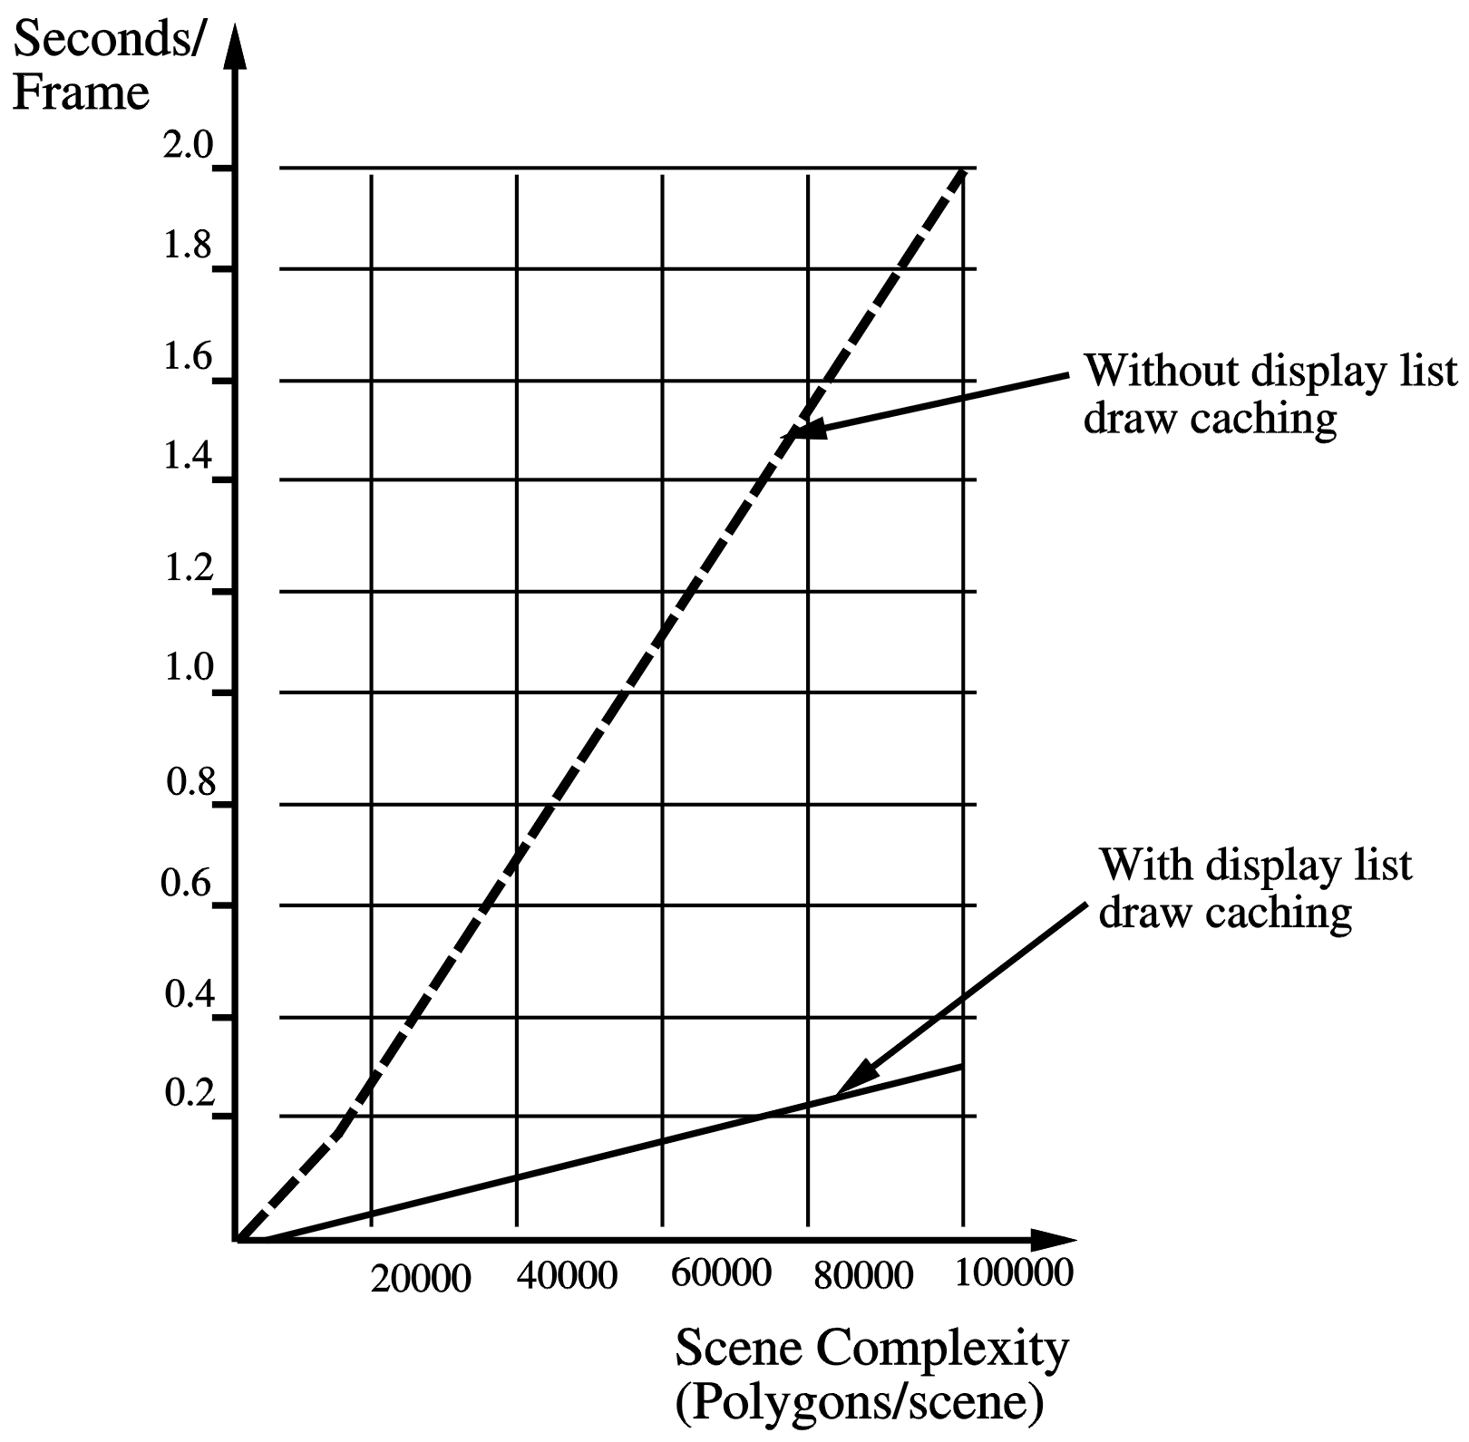
Influence of HIP Display List caching

Slide 34
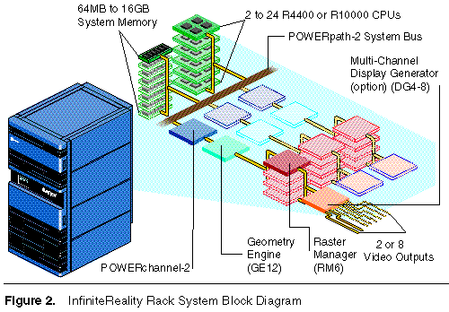

Slide 35
The SGI InfiniteReality - continued:
The HIP sends data to the geometry distributor which
distributes the load to the geometry engines on a “least busy”
fashion (with a FIFO queue);
Each Geometry Engine uses SIMD (single-instruction-
multiple-data) by processing the three coordinates of the vertex
in parallel on three “floating-point cores”.
The GE floating point core has its own ALU, multiplier and
32-word register in a four-stage pipeline;
The FIFO holds the results of the GEs output and writes the
merged stream to the vertex bus;

Slide 36
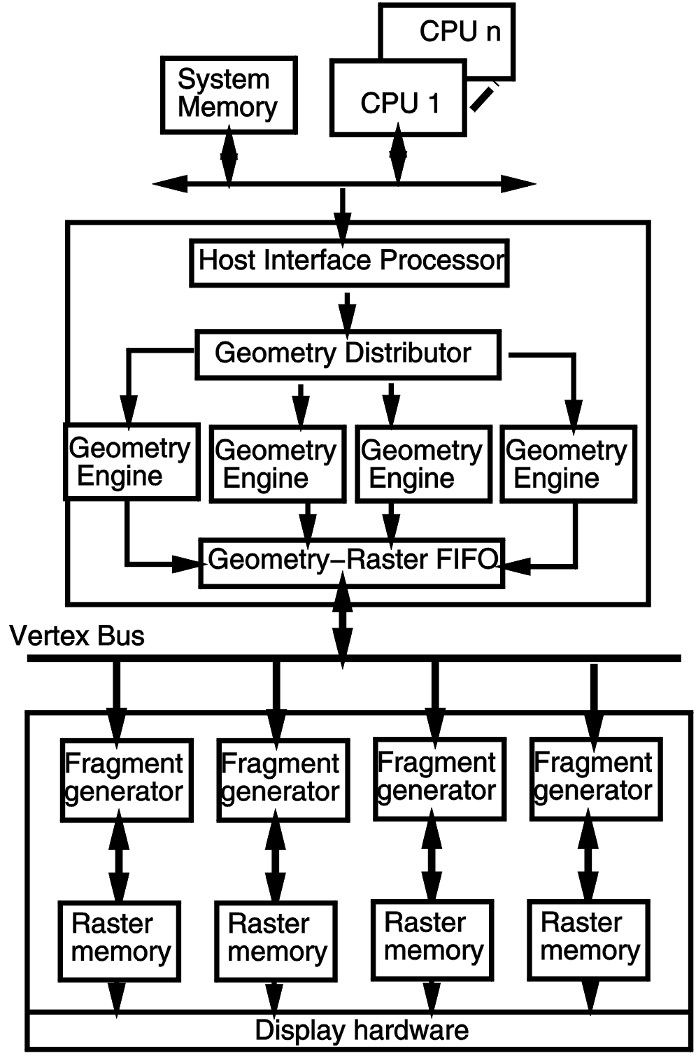
SGI Infinite Reality system architecture
Data from the vertex bus are received by the “fragment generators” on the raster memory board;
The fragment generator performs the texturing, color, depth pixel interpolation and anti-aliasing (4 to 8 sub-samples/pixel)
Their output is then distributed equally among 80 image engines on the raster board;
The image engine tiling pattern is 320x80 pixels;
The display hardware has dynamic video resize, video timing and D/A conversion;

Slide 37
Sun Blade 1000 systems
Represents a significant step in multiprocessor desktop computing by integrating new technologies into a workstation package.
Consists of UltraSPARC-III microprocessors tightly integrated into it
UltraSPARC-III microprocessors is implemented in 14 stage pipeline
UltraSPARC-III has 6 key components
Instruction Issue unit
Floating point unit
Integer execution unit
Data cache unit
External memory unit

Slide 38
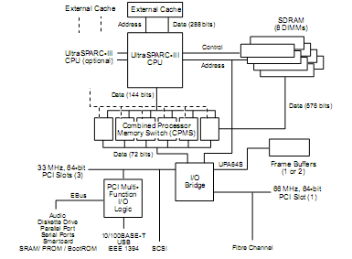
High-level architecture of the Sun Blade 1000 workstation

Slide 39
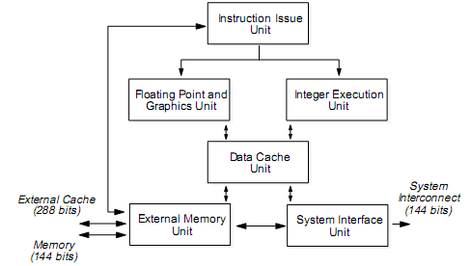
UltraSPARC-III CPU functional block diagram

Slide 40
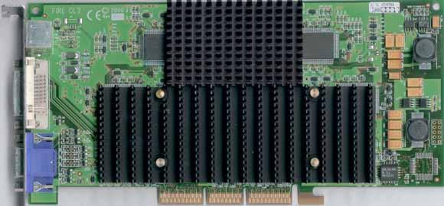
Stereo glasses
connector
Fire GL 2
Passive coolers
AGP bus connector

Slide 41
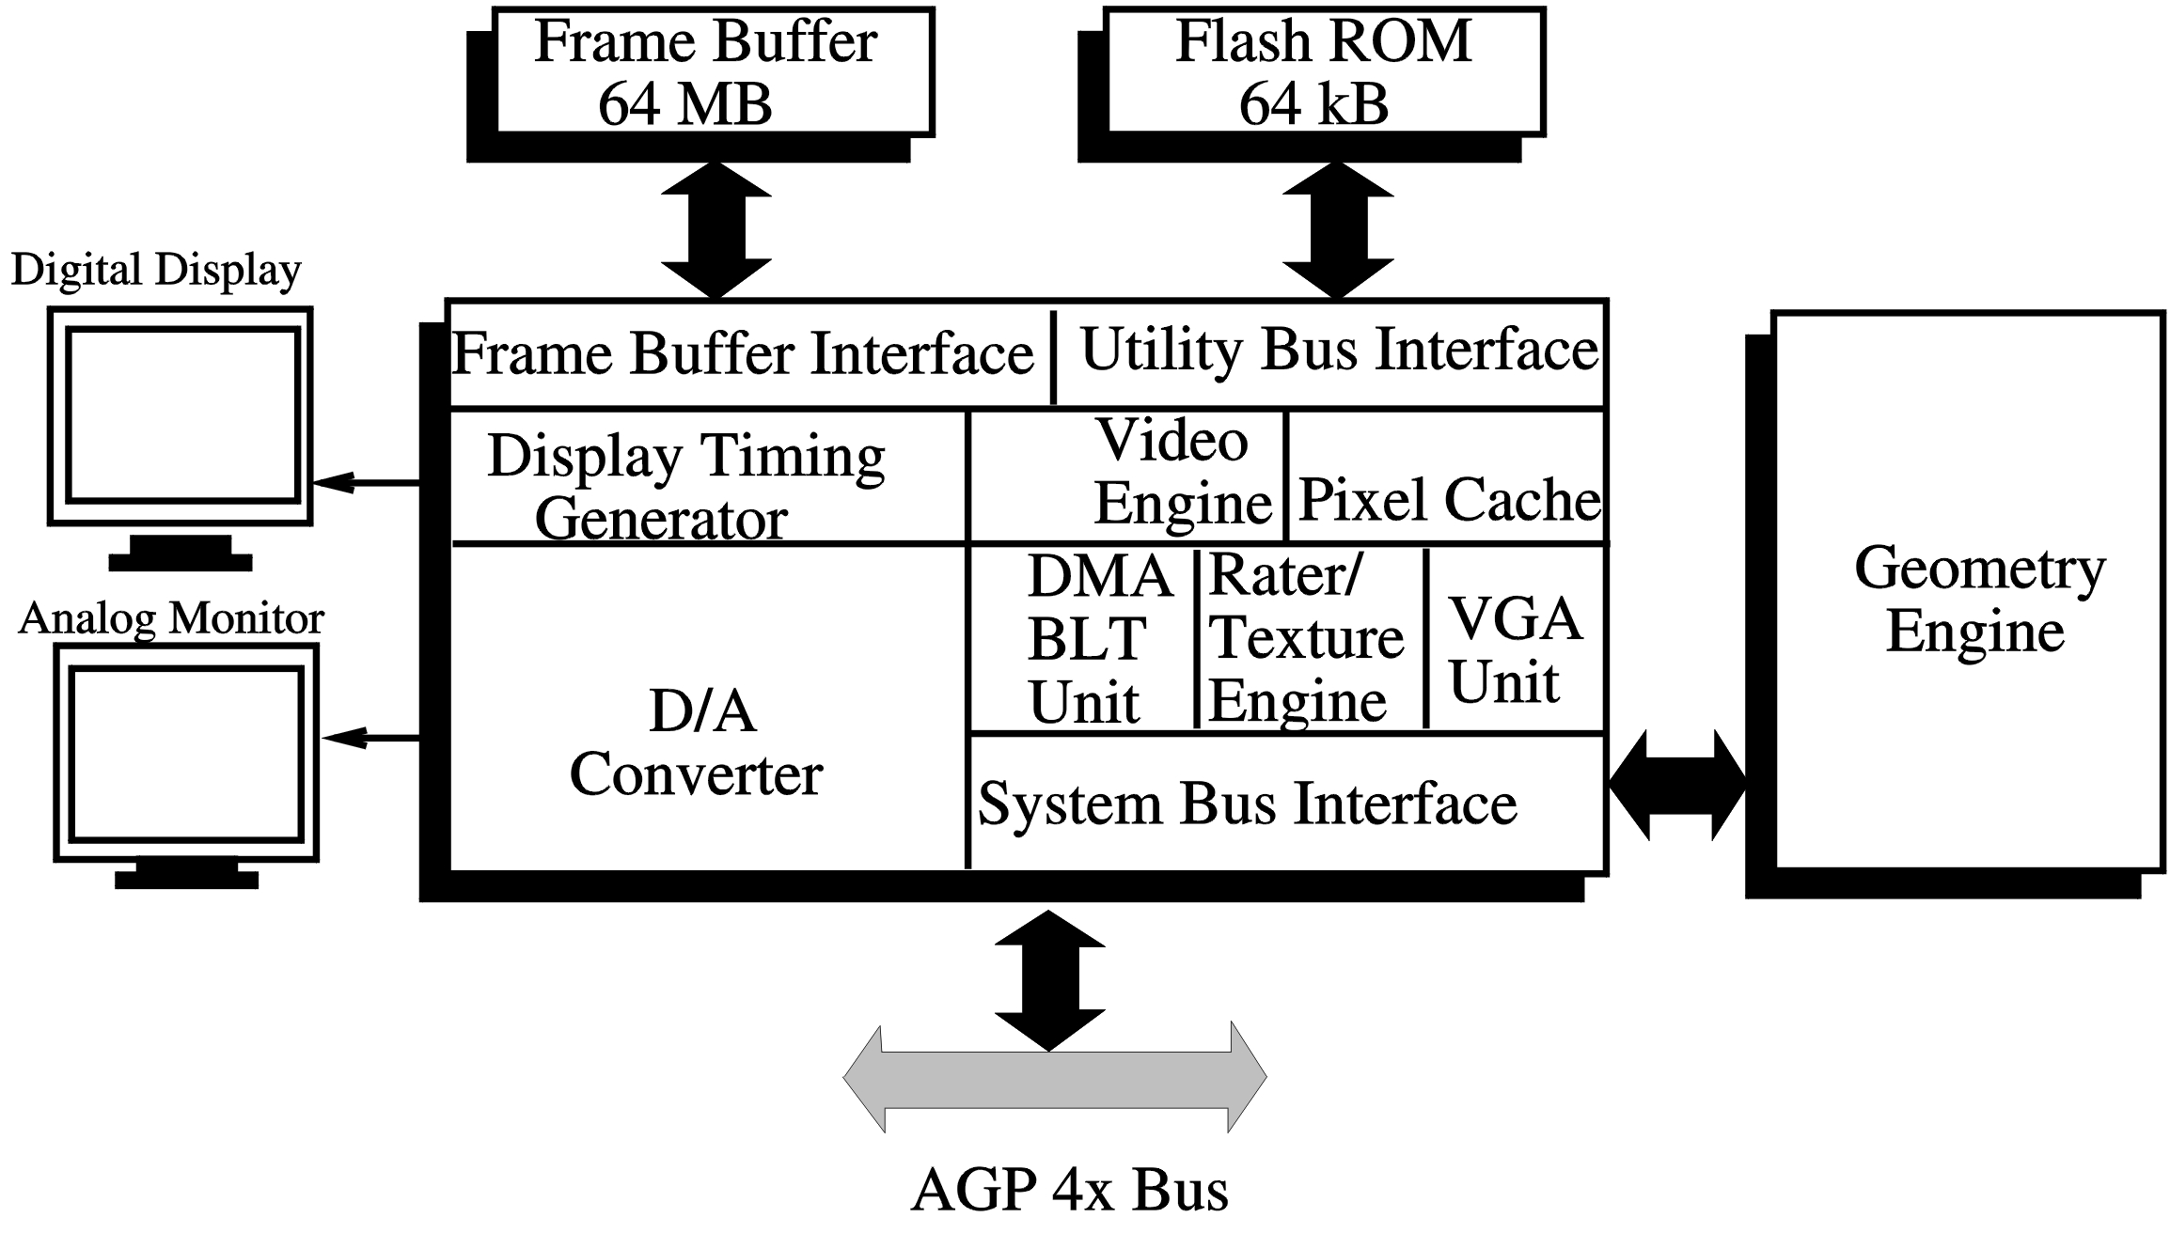
Fire GL 2 architecture

Slide 42
Fire GL 2 features:
27 Million G-shaded/sec., non-textured polygons/sec;
Fill rate is 410 M Pixels/sec.;
supports up to 16 light sources;
has a 300 MHz D/A converter

Slide 43
Distributed VR architectures
Single-user systems:
multiple side-by-side displays;
multiple LAN-networked computers;
Multi-user systems:
client-server systems;
peer-to-peer systems
hybrid systems;

Slide 44
Improving scalability of DVE
Communication architecture
Interest management
Concurrency control
Data replication
Load distribution

Slide 45
Communication architecture
Can be implemented as
Client server
Peer –to – Peer
Peer –to – Server

Slide 46
Interest management
These strategies exploit the fact that users do not need to receive all update messages related to teh whole world.
They receive only those messages in which they are interested.
Methods used
Region based
Interest based

Slide 47
Concurrency control
Replication allows local access and updates to the data
Mechanishms needed to syncronize these replicas
Approaches
Pessimistic
Optimistic
Prediction schemes

Slide 48
Data replication
Should address the issue
How efficient should the replication be
Replication implemented via 2 techiniques
Prioritized transfer of objects
Caching and Prefretching

Slide 49
Load distribution
To maintain interactive performance , dymanic load distribution schemes have been introduced where overloaded servers transfer their excessive workloads to less loaded servers.
3 approaches
Local
Global
Adapative dynamic load

Slide 50
Genlock..
If the output of two or more graphics pipes is used to drive monitors placed side-by-side, then the display channels need to be synchronized pixel-by-pixel;
Moreover, the edges have to be blended, by creating a region of overlap.

Slide 51
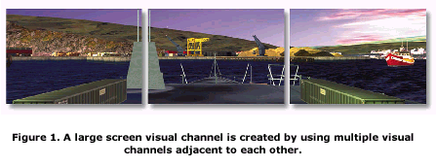

Slide 52
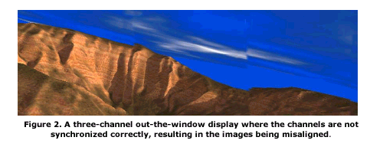
(Courtesy of Quantum3D Inc.)

Slide 53
Synchronization of displays:
software synchronized – system commands that frame processing start at same time on different rendering pipes;
does not work if one pipe is overloaded – one image finishes first
CRT
Buffer
Application
Geometry
Rasterizer
Synchronization command
CRT
Buffer
Application
Geometry
Rasterizer

Slide 54
Synchronization of displays:
frame buffer synchronized – system commands that frame buffer swapping starts at same time on different rendering pipes;
does not work because swapping depends on electronic gun refresh - one buffer will swap up to 1/72 sec before the other.
CRT
Buffer
Application
Geometry
Rasterizer
Synchronization command
CRT
Application
Geometry
Rasterizer
Buffer

Slide 55
Synchronization of displays:
video synchronized – system commands that CRT vertical beam starts at same time; one CRT becomes the “master”
does not work if horizontal beam is not synchronized too (one line too many or too few).
Master CRT
Buffer
Application
Geometry
Rasterizer
Synchronization command
Application
Geometry
Rasterizer
Buffer
Slave CRT

Slide 56
Synchronization of displays:
Best method is to have software + buffer + video synchronization of the two (or more) rendering pipes
Master CRT
Buffer
Application
Geometry
Rasterizer
Synchronization command
Synchronization command
Synchronization command
Application
Geometry
Rasterizer
Buffer
Slave CRT

Slide 57
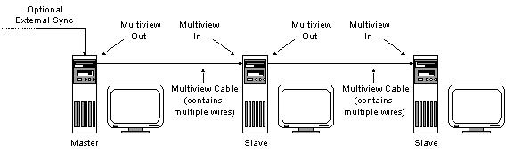
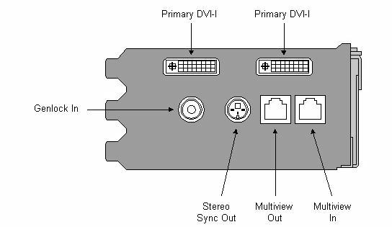
Video synchronized displays (three PCs)
release
done
(Digital Video Interface- Video out)
Wildcat 4210

Slide 58
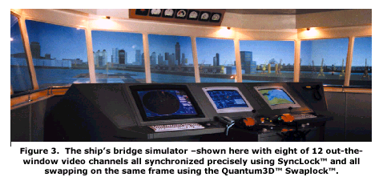

Slide 59
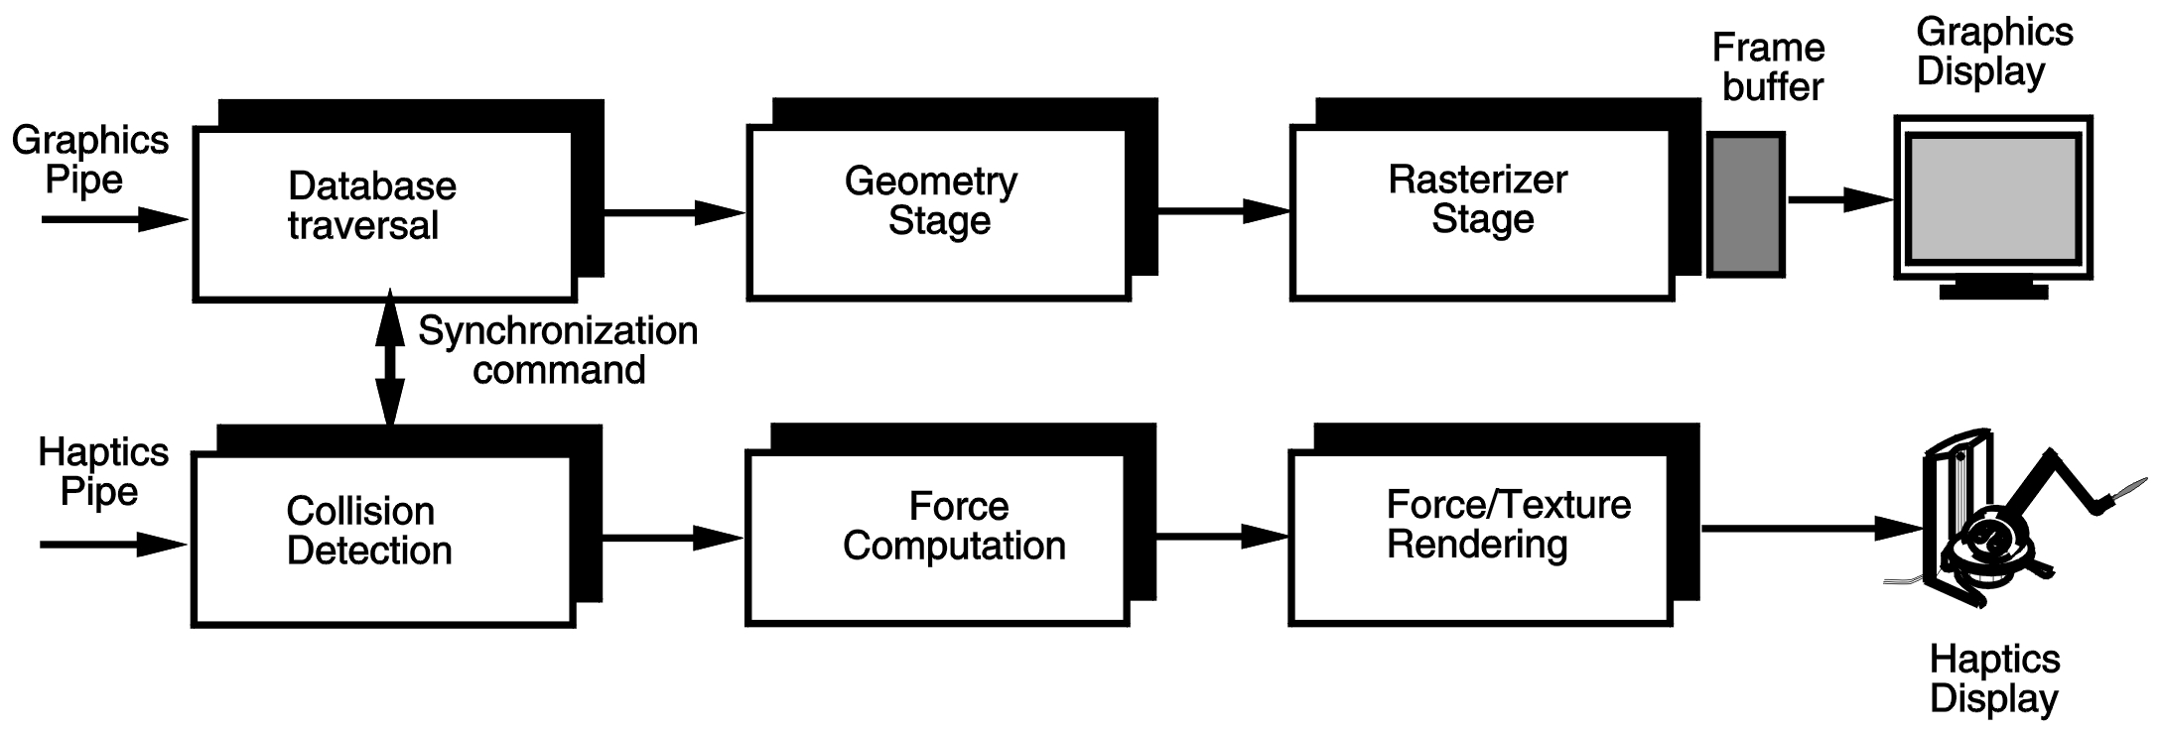
Graphics and Haptics Pipeline Synchronization:
Has to be done at the application stage to allow decoupling of the rendering stages (have vastly different output rates)

Slide 60
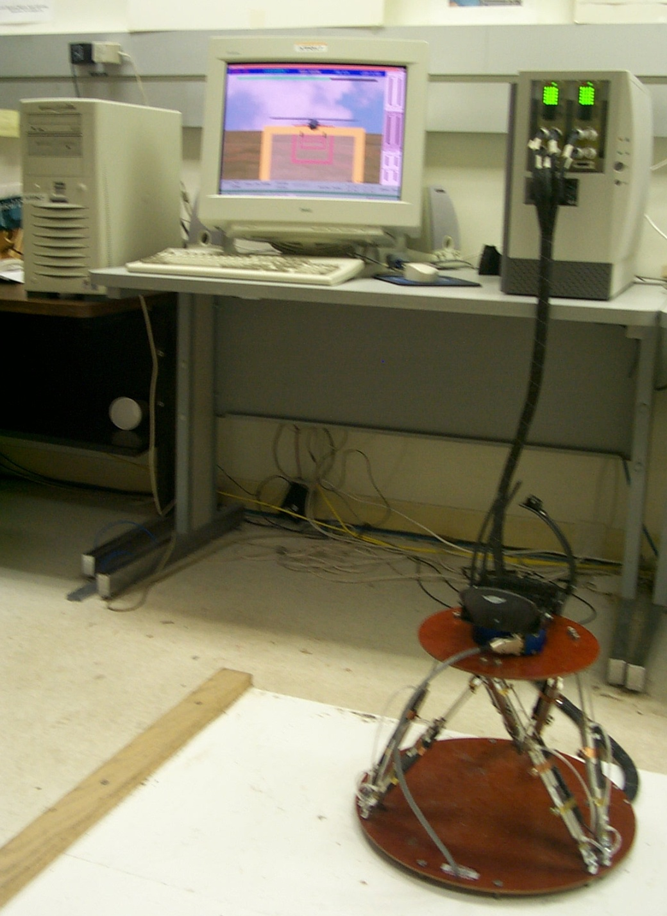
Graphics pipe
and
Haptics pipe
Haptic
Interface
Controller
(embedded
Pentium)
Pentium II
Dual-processor
Host computer
Haptic
Interface

